Slide 1
Data Analytics in Neuroscience
ConTaMiNeuro School,
Venice, 2019
Avgoustinos Vouros (avouros1@sheffield.ac.uk, https://avouros.github.io/)
Eleni Vasilaki

Slide 2
The RODA software for
Detailed behavioural analysis inside the Morris Water Maze experimental procedure.
Framework and methods explanation.

Slide 3
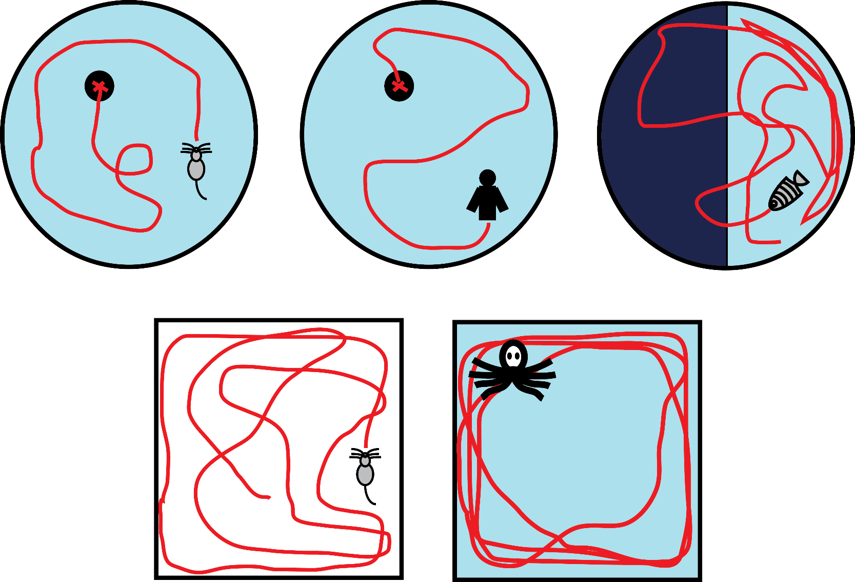
Behavioural experiments

Slide 4
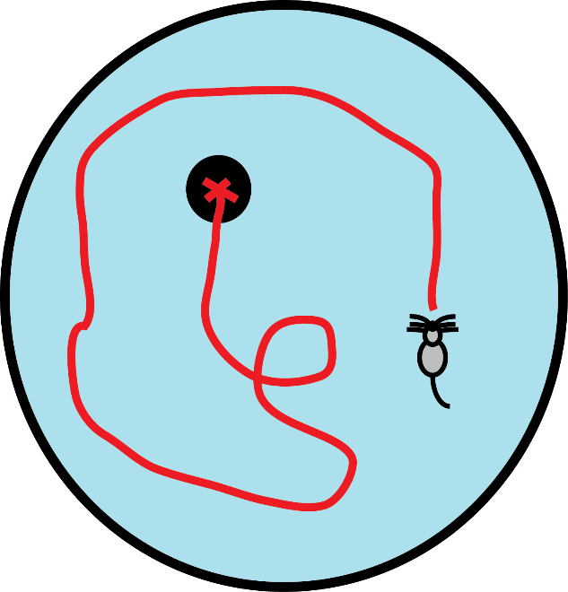
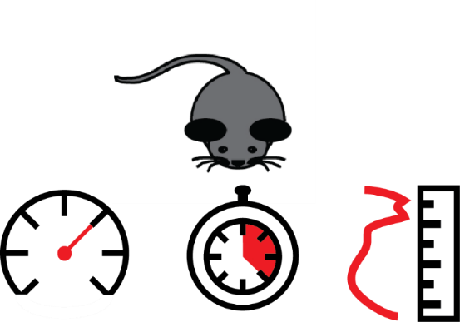
Traditional data analysis
Collect trajectory / path data.
Compute various performance measurements.
Group A: Control
Group B: Stress

Slide 5
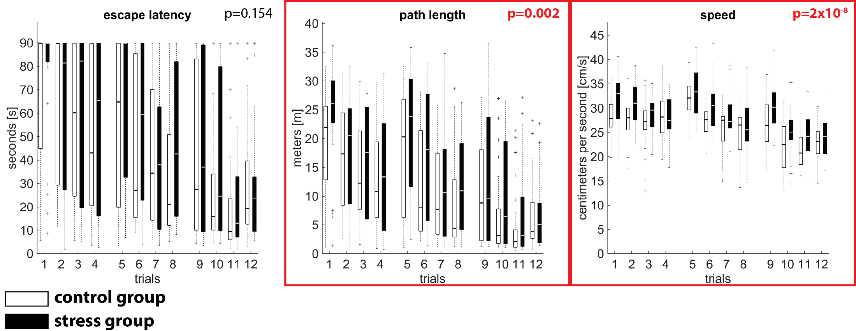
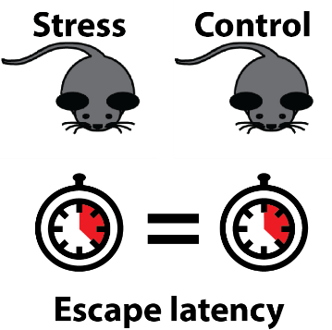
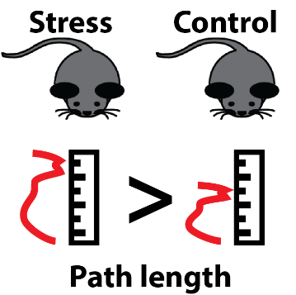
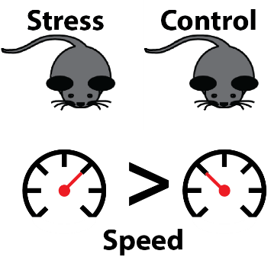
Motivation
?

Slide 6
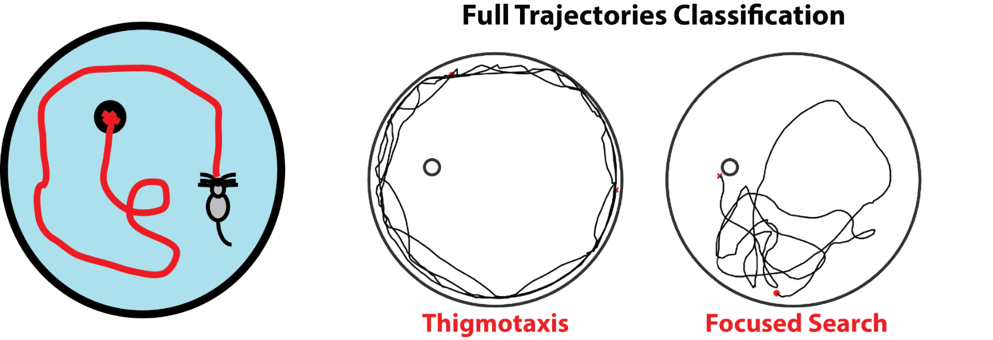
Behavioural analysis: Strategies
Quantify behavioural differences.
Dalm, S., Grootendorst, J., De Kloet, E. R. (2000).
Wolfer, D. P. & Lipp, H.-P. (2000).
Wolfer, D. P., Madani, R., Valenti, P. & Lipp, H.-P. (2001).
Graziano, A., Petrosini, L. & Bartoletti, A. (2003)
Illouz, T., Madar, R., Louzon, Y., Griffioen, K. J. & Okun, E. (2016).
Rogers, Jake, et al. (2017).
Higaki, Akinori, et al. (2018).

Slide 7
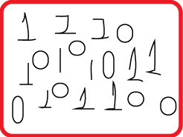
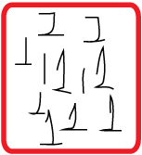


Concept of classification
Our data
Result
Our classes

Slide 8
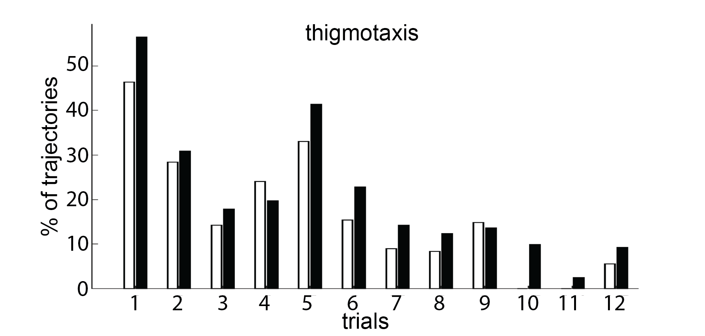
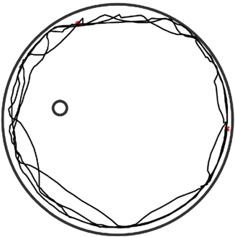

Machine learning: classification
Machine learning frameworks:
Better at quantifying behavioural differences.
stress
>
control
Limited to specific experiments (Water Maze).
Requires training, i.e. a lot of examples.

Slide 9
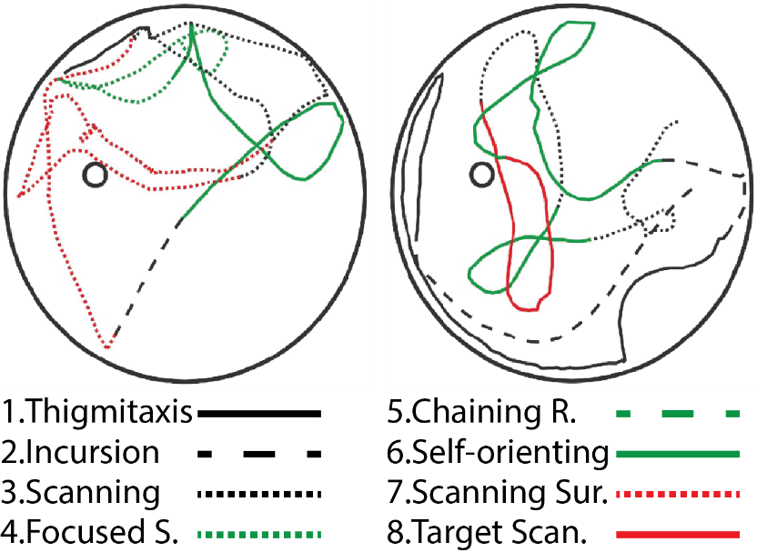
Multiple classes in one trial
Gehring, T. V., et al. (2015)

Slide 10
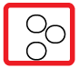
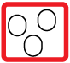
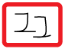
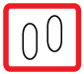
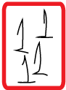
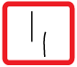
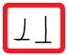
Classification vs Clustering
Our data
Classification
Clustering
Our classes

Slide 11
Classification vs Clustering
Classification: requires knowledge of the classes and training.
Clustering: groups the data based on similarity (no prior knowledge of classes is required).

Slide 12
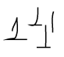

Best of both worlds: semi-supervised learning
Our data
Clustering
Result
Our classes
Labelling
ones
zeros

Slide 13
Best of both worlds
Semi-supervised learning: use only a small number of labels to guide the clustering solution.
Following we will see the concepts of clustering and semi-supervised learning in more detail…

Slide 14
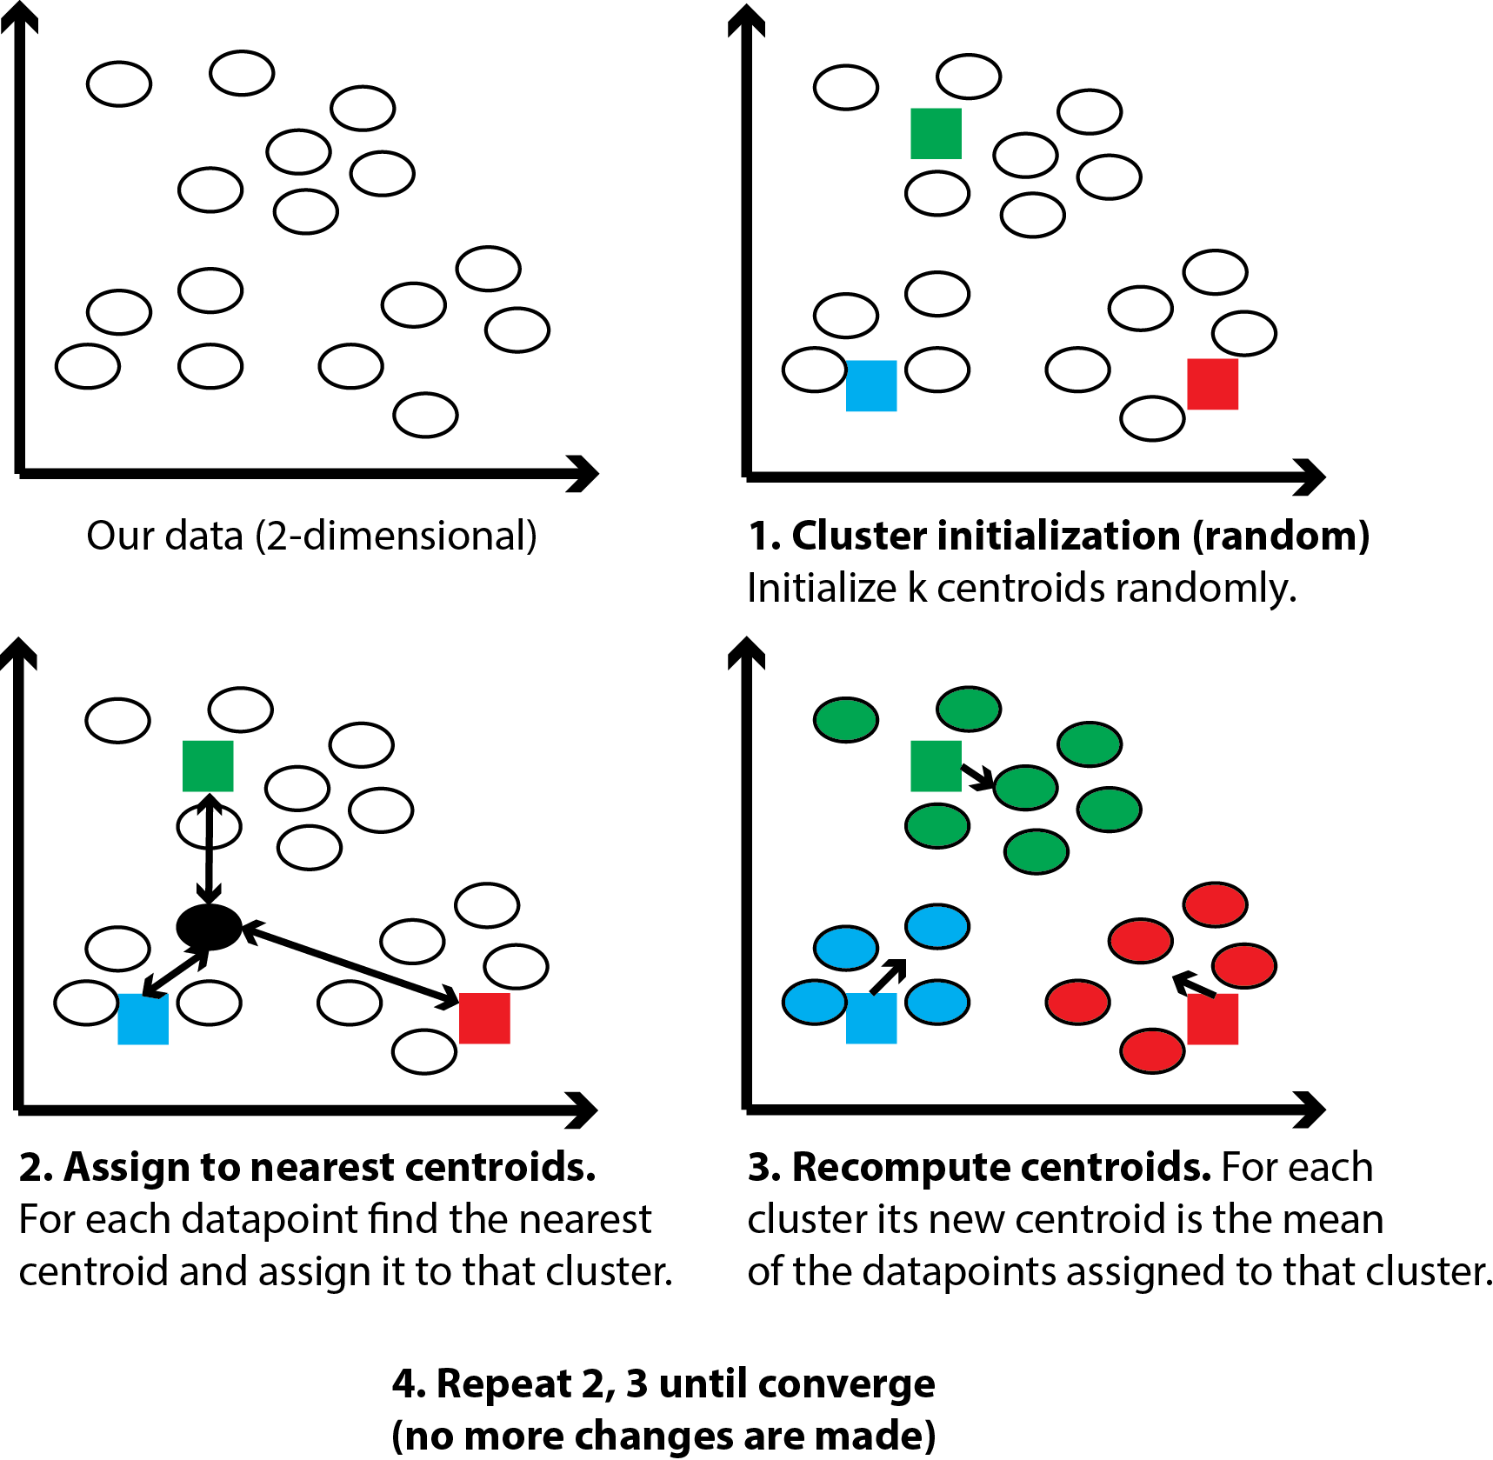
K-Means
clustering

Slide 15
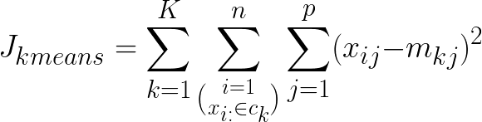
K-Means clustering
Minimize objective function wrt. m
(Within-Cluster-Sum-of-Squares):

Slide 16
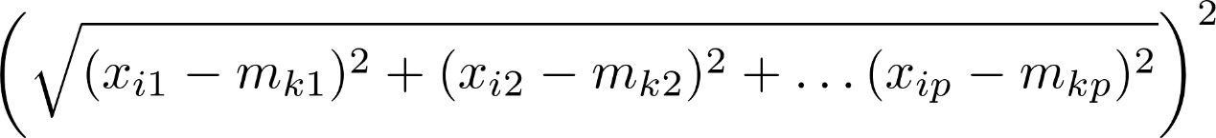
K-Means clustering
Minimize objective function wrt. m
(Within-Cluster-Sum-of-Squares):

Slide 17
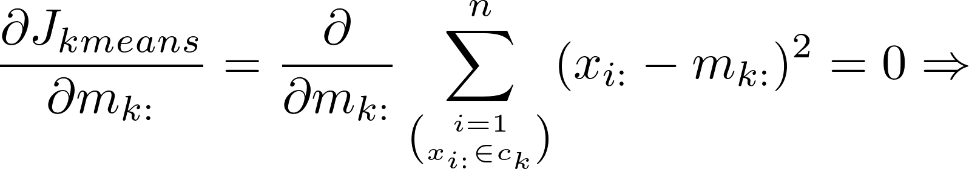
K-Means clustering
At convergence:
The gradient of the objective function with respect to the centroid equals 0.

Slide 18
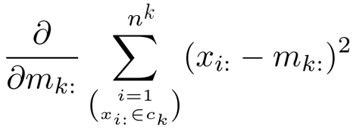
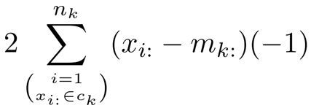
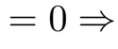
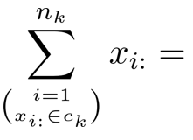
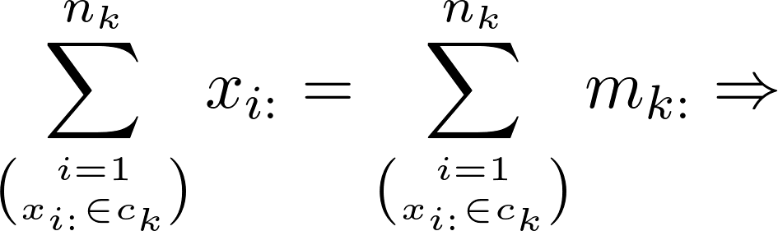
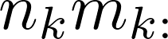
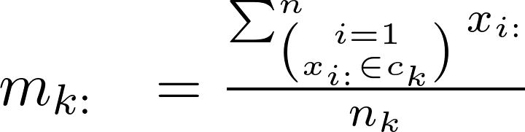
K-Means clustering
Notes:
At convergence my centroid will equal the sum of all the datapoints in the cluster divided by the number of all the datapoints in the cluster.
Based on that we construct the algorithm:

Slide 19
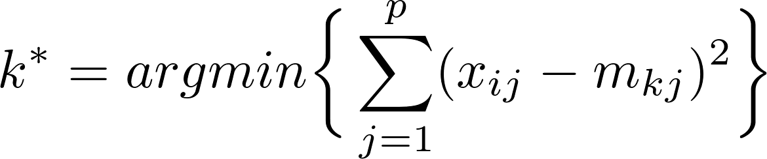
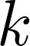
K-Means clustering
Randomly choose K points as the initial centroids.
Until convergence:
Assign each point x_{i} to the nearest cluster:
For each cluster recompute the centroid:

Slide 20
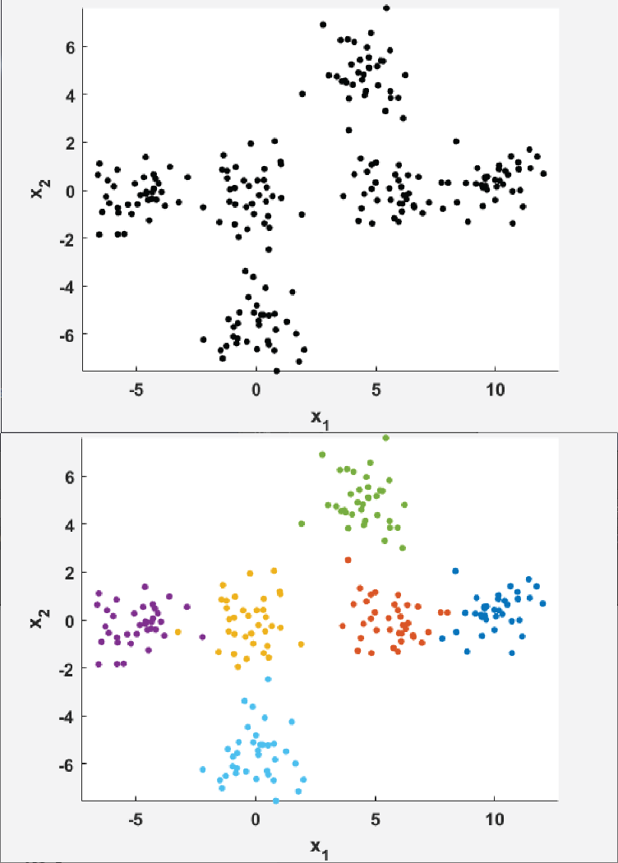
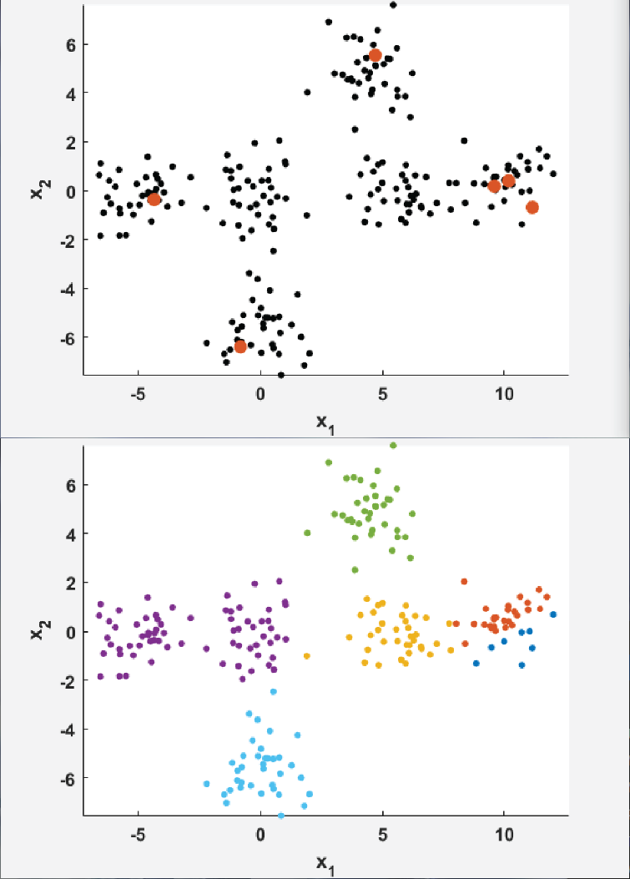
Initialization for K-Means
Random initialization
and clustering
Data and ground truth

Slide 21
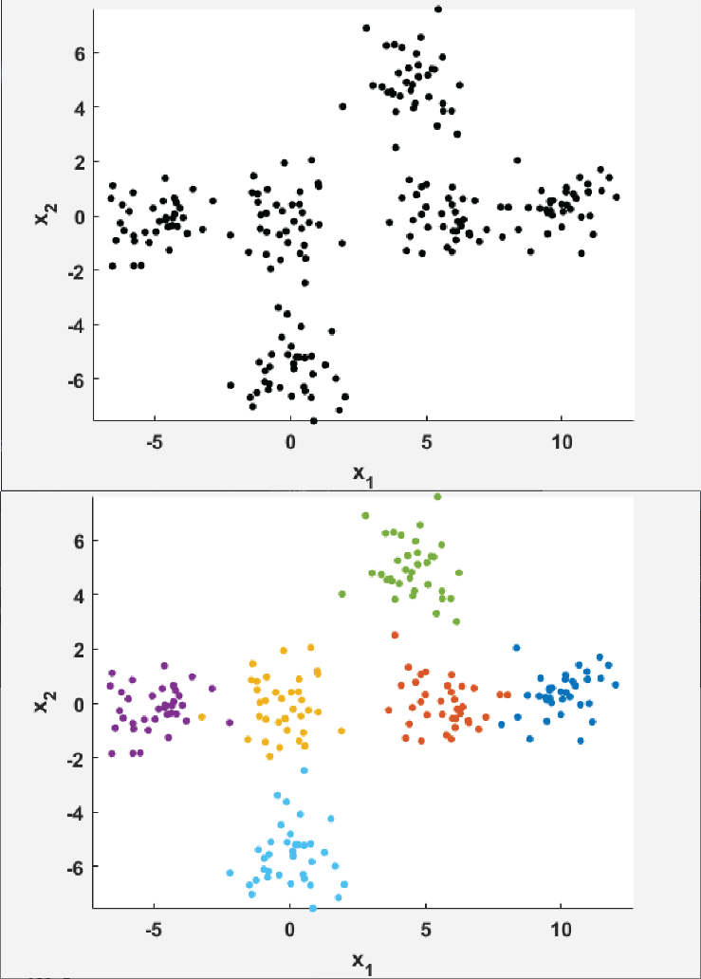
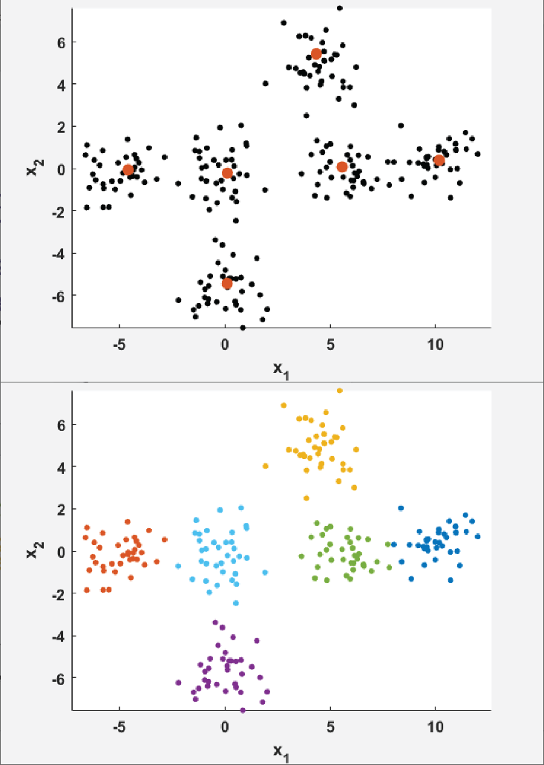
Initialization for K-Means
Vouros et al. (2019)
E.g. Density K-Means++
initialization and clustering
Data and ground truth

Slide 22
K-Means clustering
Initializations:
K-Means++ [1]
ROBIN [2]
Density K-Means++ [3]
Variations:
Lloyd’s [4]
Hartigan-Wong’s [4]
Sparse K-Means [5]
[1] Arthur & Vassilvitskii (2007)
[2] Al Hasan et al. (2009)
[3] Nidheesh et al. (2017)
[4] Slonim et al. (2013)
[5] Witten et al. (2010)

Slide 23
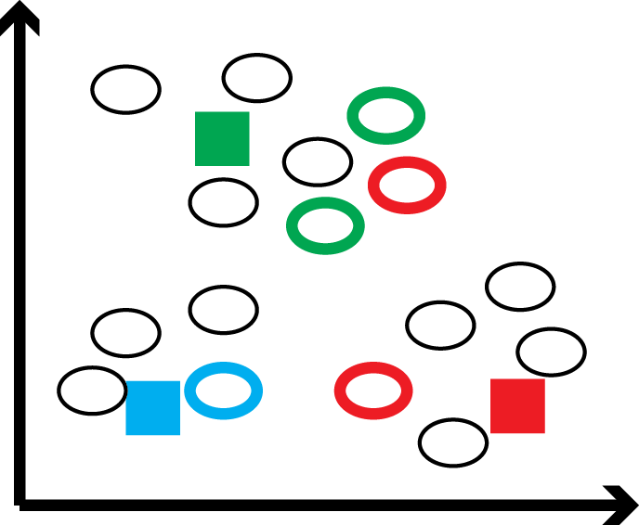
Semi-supervised learning
Partial labelling.
MUST-LINK & CANT-LINK constraints.
Cluster assignment is based on nearest centroid and constraints violation.
MPCK-Means clustering.

Slide 24
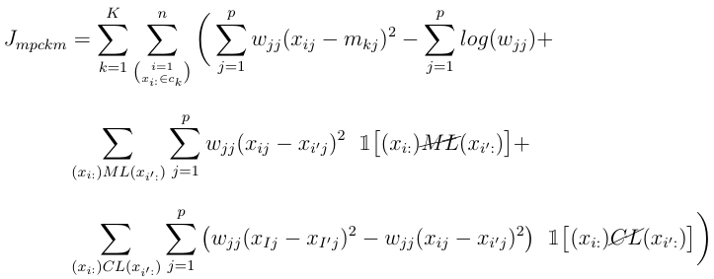
MPCK-Means
Minimize objective function wrt. m ,w:

Slide 25
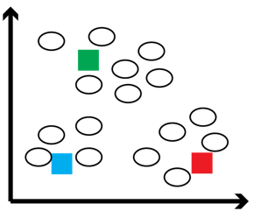
MPCK-Means
Minimize objective function wrt. m ,w:
Weighted Euclidean

Slide 26
MPCK-Means
Minimize objective function wrt. m ,w:
Normalizing constant
Notes:
Normalizing constant (practical role): we penalize values close to zero.

Slide 27
MPCK-Means
Penalty for violating
MUST-LINK constraints
Minimize objective function wrt. m ,w:

Slide 28
MPCK-Means
Penalty for violating
CANT-LINK constraints
Minimize objective function wrt. m ,w:

Slide 29
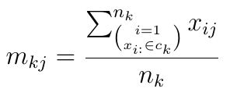
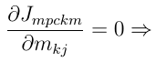
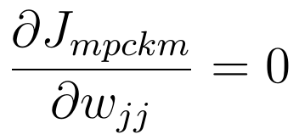
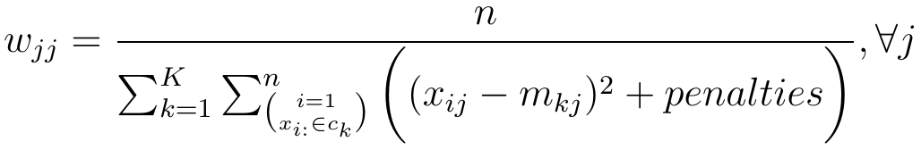
MPCK-Means
At convergence

Slide 30
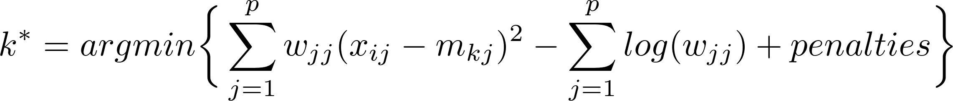
MPCK-Means
Choose K points as the initial centroids.
Until convergence:
Assign each point x_{i} to the nearest cluster:
For each cluster recompute the centroid:

Slide 31
MPCK-Means
Update the weights:

Slide 32
Our procedure
Gehring, T. V., et al. (2015).
Vouros, A., et al. (2018).

Slide 33
Our procedure
Trajectories
Segmentation
Segments of length 2.0 – 2.7 times the arena R.
Overlapping of 70%.

Slide 34
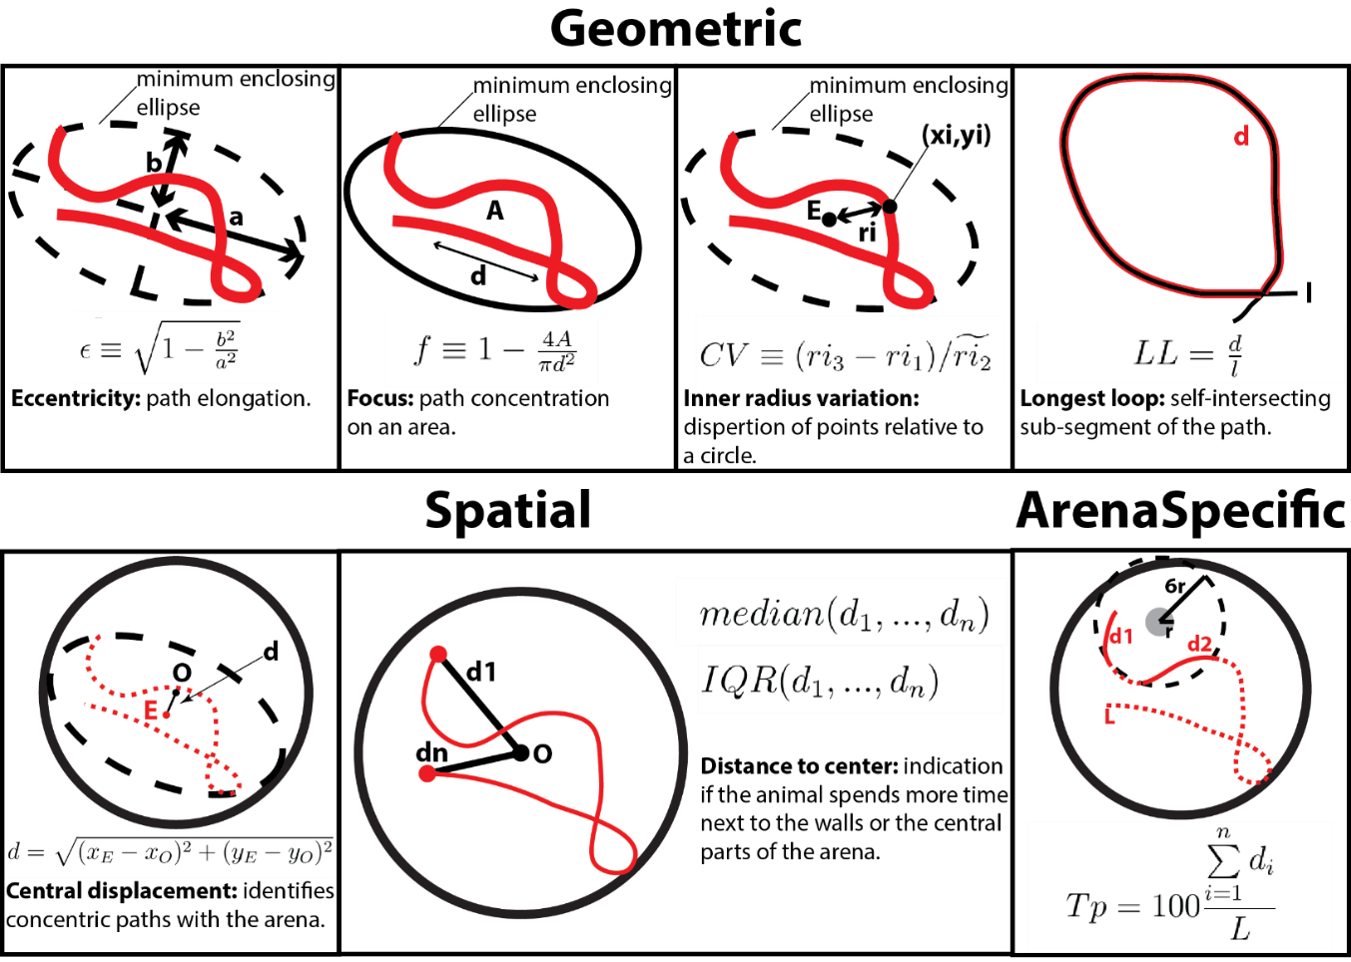
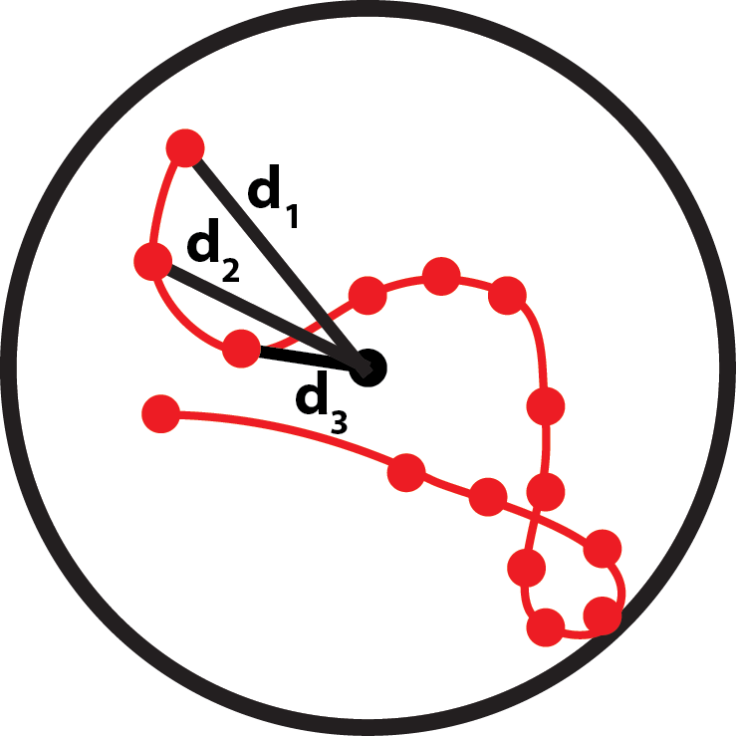
Our procedure
Feature
Computation
Example:
Average distance
to center

Slide 35
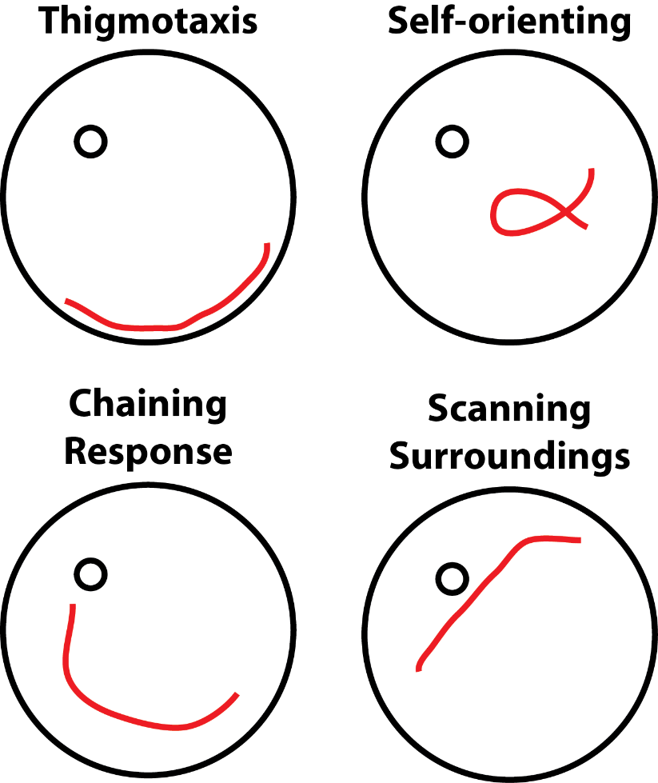
Our procedure
Partial
Labelling
8%-12% of the dataset needs to be labelled.
Notes:
Explain each block separately
Boosted block → one block

Slide 36
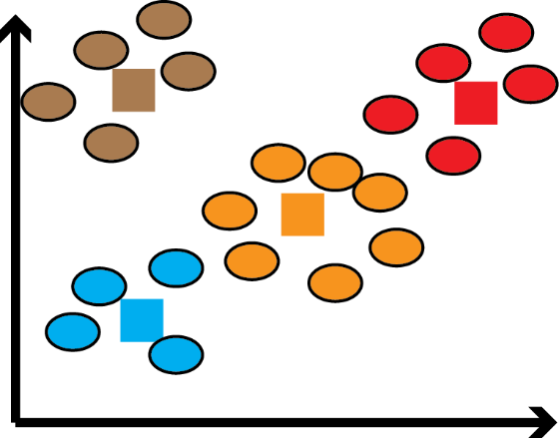
Our procedure
Classification
4 clusters
Multiple clusters can belong to the same class.
Not all MUST-LINK constraints can be satisfied.
MUST-LINK constraints can have negative impact on clustering.
2 classes

Slide 37

Our procedure
Classification
2-stage clustering.

Slide 38

How do we estimate K?
K ?
Cross-validation and select best classifiers

Slide 39



Mike Croucher, NAG
(Visiting Senior RSE @SheffieldUni)

Slide 40




Case study I
Vouros, A.,
et al. (2018)
full trajectories
classification
performance
measurements
RODA
classification

Slide 41


Case study II
Huzard, D.,
et al. (2019)

Slide 42




Case study II
Huzard, D.,
et al. (2019)

Slide 43
Case study II
Huzard, D.,
et al. (2019)
Demonstrate learning by gradually evolving their strategies.
Dominant strategy of this group is the self-orienting.
Low line rats show deficits in spatial reversal learning because they need to learn the location of the platform again.
Weak learning.
Adapt the Chaining Response.
Similar to Low they evolve their strategies but much faster.
Do not show deficits in spatial reversal learning.

Slide 44

Exercise 1
This is a demo of RODA released only for ConTaMiNeuro. For the full software refer to the releases.
Aim: Familiarize with the
RODA software and its
analysis pipeline.
Load a RODA project.
Complete the partial labelling by giving 8 labels.
Run the classification procedure.
Results for Low vs Inter animal groups.

Slide 45

About the data set:
It contains trajectories from 30 male Wistar Han rats from 3 rat lines selected for differential corticosterone reactivity (Low, Inter, High) during the Reversal Training. The trajectories are already segmented.
The dataset is available to the ConTaMiNeuro participants.
Huzard, D., Vouros, A., Monari, S., Astori, S., Vasilaki, E., & Sandi, C. (2019). Constitutive differences in glucocorticoid responsiveness are related to divergent spatial information processing abilities. Stress, 1-13.

Slide 46


For this demo many of the steps of the analysis procedure have already been completed. This is due to the time constraints. A full analysis takes around 30-45min of user interaction with the software and 2-5hours (depending on the size of the data set) of processing. For the full software and instructions refer to https://github.com/RodentDataAnalytics/mwm-ml-gen/wiki
Load a RODA project.
The users first need to set up their project specifying their experimental procedure properties and load their raw data (files containing [time,x,y] coordinates) to the software. This process creates their project and for this tutorial it is already completed so we will proceed to load the project.
Navigate to data\reverse_training_male\
and click on the .cfg file.

Slide 47



The original trajectories have already been segmented and this resulted to the generation of ~20.000 segment. For these segments the features have already been computed and we can now proceed to the labelling process. Here we only use a small subset of the whole data set which is already labelled but missing only 8 labels.
Complete the labelling

Slide 48



Load the already available labels
Provide labels to:
Trajectory 2, segment 1
Trajectory 29, segment 18
Trajectory 35, segment 12
Trajectory 37, segment 3
Trajectory 38, segment 7
Trajectory 59, segment 7
Trajectory 68, segment 15
Trajectory 82, segment 7

Slide 49


(1)
(2)
(3)
(4)
Trajectory 2, segment 1
Trajectory 29, segment 18
Trajectory 35, segment 12
Trajectory 37, segment 3
Trajectory 38, segment 7
Trajectory 59, segment 7
Trajectory 68, segment 15
Trajectory 82, segment 7
(5)
(6)
(7)
(8)
Save your labels and exit:
Examples

Slide 50


The original classification process requires around 4 hours to be completed while the reduced data set is too small for it. For these reasons in this demo it will be bypassed (completed immediately) since we have the labels for all the segments.
Run the classification
Make sure the correct files are selected:
Run the default classification.

Slide 51




Results
Figures will be stored in the results folder located in the project folder.
Low group = 1
Inter group = 2
p-values in the terminal
window
The demo software generates limited files but you can see the p-values in MATLAB’s command window or the terminal window in Windows.

Slide 52

Results

Slide 53
Hands-on Data clustering
Building clustering frameworks

Slide 54
Unsupervised pattern detection
K-Means clustering:
Sensitive to the initial centroids.
It requires the number of target clusters K.
Sensitive to features (data attributes).

Slide 55
Initialization methods
Pick datapoints as initial centroids:
K-Means++: selected datapoints are away from each other.
ROBIN: selected datapoints are away from each other and at dense regions of the feature space.
DK-Means++: similar to ROBIN but deterministic.

Slide 56




Clustering tuning and evaluation
Internal methods:
Measure the quality of the clustering solution.
Example: Silhouette
-1 ≤ s(i) ≤ 1

Slide 57

Clustering tuning and evaluation
External methods:
Assume prior knowledge of the clusters and measure accuracy. Example: Purity

Slide 58

Exercise 2
ClusteringWorkplace is an active project and will be updated constantly.
https://github.com/avouros/clustering-workplace
Aim: Apply the presented
Initialization and clustering
methods to analyze toy
datasets.
Load a dataset.
Select an initialization and a clustering method.
Select a range of values for the parameters.
Run the clustering and see your performance.

Slide 59



Load a dataset
datasets\real\

Slide 60


Select an initialization and a clustering method
Run the clustering and see your performance.
Select a range of values for the parameters.

Slide 61

Internal methods:
External methods:
purity
entropy
F-score
Accuracy
Recall
Specificity
Precision
(w)Silh2: Silhouette
(w)DBi: Davies-Bouldin Index
(w)BRi: Banfield-Raftery Index
(w)Chi: Calinski-Harabasz Index
Centroids:
A GUI for visualizing initial and
final centroids locations.

Slide 62
62
Project Part A
Aim: Study the effect of different initialization techniques on
various clustering algorithms (Lloyd’s K-Means and K-Medians).
See Vouros et al. (2019) https://arxiv.org/abs/1908.09946.
Compare the performance of simple and sophisticated methods for the same algorithm.
Hypothesis: deterministic methods can improve the on average the clustering performance.
ClusteringWorkplace is an active project and will be updated constantly.
https://github.com/avouros/clustering-workplace

Slide 63
63
Project Part A
For each one of the Yan and Ye, Gap (exclude Gap 1) and Mixed models…
Select a clustering algorithm, K-Means (Lloyds) or K-Medians.
Test either the K-Means++ and Density K-Means++ or the ROBIN and Density K-Means++ initialization methods.
Obtain the clustering (external) performance using either the purity index or the F-score index and use it to compare your two initialization methods.

Slide 64

64
true number of clusters of the dataset
Project Part A
available initialization methods
available datasets
available clustering algorithms
For which ks to execute the clustering.
Pick start k = true number of clusters
and end k = true number of clusters

Slide 65



65
Project Part A
(2) IMPORTANT: save your dataset and clustering.
(a) You will be asked to specify a folder name and a location
where the results will be stored.
(b) You will be asked if you want to extract the clustering results to csv files, click Yes.
(1) Execute your clustering
(3) Navigate to the folder you had previously specified:
(a) k6s0 folder: contains your clustering results (k=6 is the number of clusters, ignore s).
(b) cl_res.mat: this file can you used to reload your results in the GUI
(c) data.csv: your clustered dataset; rows=observations, columns=features.
(d) info.csv: information about your clustering, which methods and features you used.
k6s0 folder:
assignments.csv: contains the cluster assignment of each datapoint.
finalCentroids.csv: centroid locations after convergence each row is
a centroid and each column a dimension (feature).
(c) initialCentroids.csv: initial centroid locations each row is a centroid
and each column a dimension (feature).

Slide 66



66
Project Part A
(1) Select performance (external)
(2) Click the save button
(3) A file will be generated containing
the values of the external indexes
(ignore sparsity). Use either purity or
F-Score to access your performance.

Slide 67

67
Project Part A
Other capabilities and files
Specify which features to use for the clustering.
Preprocessing: specify normalization method:
(a) One (or unity): sum to 1.
(b) n-norm (n=2): Euclidean normalization.
(c) z-score: Z-Score normalization.
(d) scale (0-1): scales the values between 0 and 1
data_original.csv: in case normalization and/or feature selection has been used then the data.csv file will contain the normalized and/or reduced dimensionality dataset. data_original.csv contains the original unnormalized dataset. The first row contains the labels.
local_outlier_factor.csv: refer to the study of Al Hasan et al. (2009).
(c) k6s0 folder / featureWeights.csv: In case the Sparse K-Means algorithm has been used each feature will have received a coefficient based on its contribution to the clustering. This file contains these coefficients. For algorithms apart from Sparse K-Means coefficients will be all equal to 1. Also in the case of Sparse K-Means another parameter needs to be specified called sparsity (s). The folder name will be then modified to be number of clusters followed by the number of sparsity parameter used for clustering.

Slide 68
68
Project Part B
For each one of the Yan and Ye, Gap (exclude Gap 1) and Mixed models…
Select a clustering algorithm, K-Means (Lloyds) or K-Medians.
Test either Density K-Means++ or the ROBIN-DETERM initialization methods.
Obtain the clustering (internal) performance using any three methods of your choice and compare them.

Slide 69
69
Project Part B
available initialization methods
available datasets
available clustering algorithms
For which ks to execute the clustering.
Pick start k = 2
and end k = number of clusters x2

Slide 70


70
Project Part B
(2) IMPORTANT: save your dataset and clustering.
(a) You will be asked to specify a folder name and a location
where the results will be stored.
(b) You will be asked if you want to extract the clustering results to csv files, click Yes.
(1) Execute your clustering
(3) Navigate to the folder you had previously specified:
(a) k2s0 folder: contains your clustering results (k=2 is the number of clusters, ignore s).
(b) cl_res.mat: this file can you used to reload your results in the GUI
(c) data.csv: your clustered dataset; rows=observations, columns=features.
(d) info.csv: information about your clustering, which methods and features you used.
k2s0 folder (and other similar folders):
assignments.csv: contains the cluster assignment of each datapoint.
finalCentroids.csv: centroid locations after convergence each row is
a centroid and each column a dimension (feature).
(c) initialCentroids.csv: initial centroid locations each row is a centroid
and each column a dimension (feature).

Slide 71



71
Project Part B
(1) Select performance (internal)
(2) Click the save button
(3) A file will be generated
containing the values of the
internal indexes for each k
(ignore s). Use three of them
To test which one is better to
evaluate the true number of
cluster of the dataset.
For the abbreviations refer to:
https://github.com/avouros/clustering-workplace

Slide 72
72
Project Part B
Other capabilities and files
Specify which features to use for the clustering.
Preprocessing: specify normalization method:
(a) One (or unity): sum to 1.
(b) n-norm (n=2): Euclidean normalization.
(c) z-score: Z-Score normalization.
(d) scale (0-1): scales the values between 0 and 1
data_original.csv: in case normalization and/or feature selection has been used then the data.csv file will contain the normalized and/or reduced dimensionality dataset. data_original.csv contains the original unnormalized dataset. The first row contains the labels.
local_outlier_factor.csv: refer to the study of Al Hasan et al. (2009).
(c) k2s0 folder / featureWeights.csv: In case the Sparse K-Means algorithm has been used each feature will have received a coefficient based on its contribution to the clustering. This file contains these coefficients. For algorithms apart from Sparse K-Means coefficients will be all equal to 1. Also in the case of Sparse K-Means another parameter needs to be specified called sparsity (s). The folder name will be then modified to be number of clusters followed by the number of sparsity parameter used for clustering.

Slide 73
73
Project Part C
Aim: Apply clustering methods on the Morris Water Maze dataset
from the study of Huzard et al (2019). You can use the ClusteringWorkplace from Exercise 2.
A subset of that dataset is available for the ConTaMiNeuro participants under the google drive folder shared with them (Data Analytics in Neuroscience/data/MWM_male_reverse.mat and Data Analytics in Neuroscience/data/MWM_male_reverse.csv).
This exercise requires programming. Ideally you should parse the data from the csv file using your favorite programming language or software and try to see if the classes can be clustered. R language contains most of the methods covered in this tutorial.
Alternatively you can perform a manual check on the features and using statistics try to identify dominant features of each strategy. Refer to the similar study: https://www.biorxiv.org/content/10.1101/576942v1.abstract

Slide 74
74
Project Part C
List of behavioural classes is available here:
https://github.com/RodentDataAnalytics/mwm-ml-gen/wiki/List-of-Labels
List of features:
Median radius
IQR radius
Focus
Centre displacement
Inner radius
Platform proximity
Eccentricity
Longest loop
Latency
Path length
Average speed
For more information about each feature refer to: https://www.nature.com/articles/srep14562

Slide 75

Thank you for your attention!

Slide 76
Further reading
Clustering initialization methods:
Clustering benchmarking:
Celebi, M. E., Kingravi, H. A., & Vela, P. A. (2013). A comparative study of efficient initialization methods for the k-means clustering algorithm. Expert systems with applications, 40(1), 200-210.
Vouros, A., Langdell, S., Croucher, M., & Vasilaki, E. (2019). An empirical comparison between stochastic and deterministic centroid initialisation for K-Means variations. arXiv preprint arXiv:1908.09946.
ROBIN:
Al Hasan, Mohammad, et al. "Robust partitional clustering by outlier and density insensitive seeding." Pattern Recognition Letters 30.11 (2009): 994-1002.
Density K-Means++:
Nidheesh, N., KA Abdul Nazeer, and P. M. Ameer. "An enhanced deterministic K-Means clustering algorithm for cancer subtype prediction from gene expression data." Computers in biology and medicine 91 (2017): 213-221.

Slide 77
Further reading
Clustering algorithms:
Lloyd’s and Hartigan-Wong’s K-Means
Slonim, N., Aharoni, E., & Crammer, K. (2013, June). Hartigan's K-Means Versus Lloyd's K-Means—Is It Time for a Change?. In Twenty-Third International Joint Conference on Artificial Intelligence.
MPCK-Means:
Bilenko, M., Basu, S., & Mooney, R. J. (2004, July). Integrating constraints and metric learning in semi-supervised clustering. In Proceedings of the twenty-first international conference on Machine learning (p. 11). ACM.
Sparse K-Means:
Witten, D. M., & Tibshirani, R. (2010). A framework for feature selection in clustering. Journal of the American Statistical Association, 105(490), 713-726.

Slide 78
Further reading
Clustering evaluation methods:
Rendón, E., Abundez, I., Arizmendi, A., & Quiroz, E. M. (2011). Internal versus external cluster validation indexes. International Journal of computers and communications, 5(1), 27-34.
Desgraupes, B. (2013). Clustering indices. University of Paris Ouest-Lab Modal’X, 1, 34.

Slide 79
Further reading
Behavioural analysis
Morris Water Maze and RODA:
Huzard, D., Vouros, A., Monari, S., Astori, S., Vasilaki, E., & Sandi, C. (2019). Constitutive differences in glucocorticoid responsiveness are related to divergent spatial information processing abilities. Stress, 1-13.
Vouros, A., Gehring, T. V., Szydlowska, K., Janusz, A., Tu, Z., Croucher, M., ... & Vasilaki, E. (2018). A generalised framework for detailed classification of swimming paths inside the Morris Water Maze. Scientific reports, 8(1), 15089.
Gehring, T. V., Luksys, G., Sandi, C., & Vasilaki, E. (2015). Detailed classification of swimming paths in the Morris Water Maze: multiple strategies within one trial. Scientific reports, 5, 14562.
Other:
Chhabria, K., Vouros, A., Gray, C., MacDonald, R. B., Jiang, Z., Wilkinson, R. N., ... & Chico, T. (2019). Sodium nitroprusside prevents the detrimental effects of glucose on the neurovascular unit and behaviour in zebrafish. bioRxiv, 576942.

